Slide 1

DriverPass System Analysis
Mark Vincent Francisco
Notes:
[No speaker notes required for this slide.]

Slide 2

System Requirements
Functional Requirements
The system shall be able to match a client with a driver with a specified time slot
The system shall be able to let the administrator to disable training packages as he/she see fit
Nonfunctional Requirements
Environments the system needs to run in:
Computers with a web browser
Mobile devices with a web browser
Accessible offline as well as over the cloud
How fast the system should run
Unspecified; however, industry standard performance is recommended.
Notes:
Hello everyone, I am pleased to explain to you the functional and nonfunctional requirements of the DriverPass software design. Think of functional requirements as what interactive aspect the software can provide to the users (i.e. what buttons to click and what it can accomplish). And you can think of nonfunctional requirements as another term for performance requirements for the system. The functional requirements include allowing the client to add, remove and modify their reservations online and being able to add time slots and specify which driver they prefer to train with. Another functional requirement is allowing the owner(the administrator) to disable training packages as he/she sees fit for the benefit of the company and clients. Nonfunctional requirements on the other hand include: allowing user to access the system through a computer, mobile device or tablet, and offline(as well as over the cloud). The system should also run as fast as what industry standard performance portrays.
There are of course, a lot more functional and nonfunctional requirements needed for the DriverPass software, but these are just a couple important ones to go over today. These requirements meet the needs of DriverPass because the administrator and the IT officer stressed the importance of allowing clients and the secretary to reserve, modify, or remove time slots from the schedule. Accomplishing this would make the business process streamline. As for training packages, the owner must be able to disable and enable training packages as they see fit because of market shifts or company capabilities.
The nonfunctional requirements meet the needs of DriverPass because the owner of the company requested that it would be available on many devices, with or without an internet connection. This requirement allows for a wider scope of users and functionality without wifi. The requirement of speed is also important as it is going to directly affect the user experience; slow system, user frustrated; fast system, user happy.

Slide 3
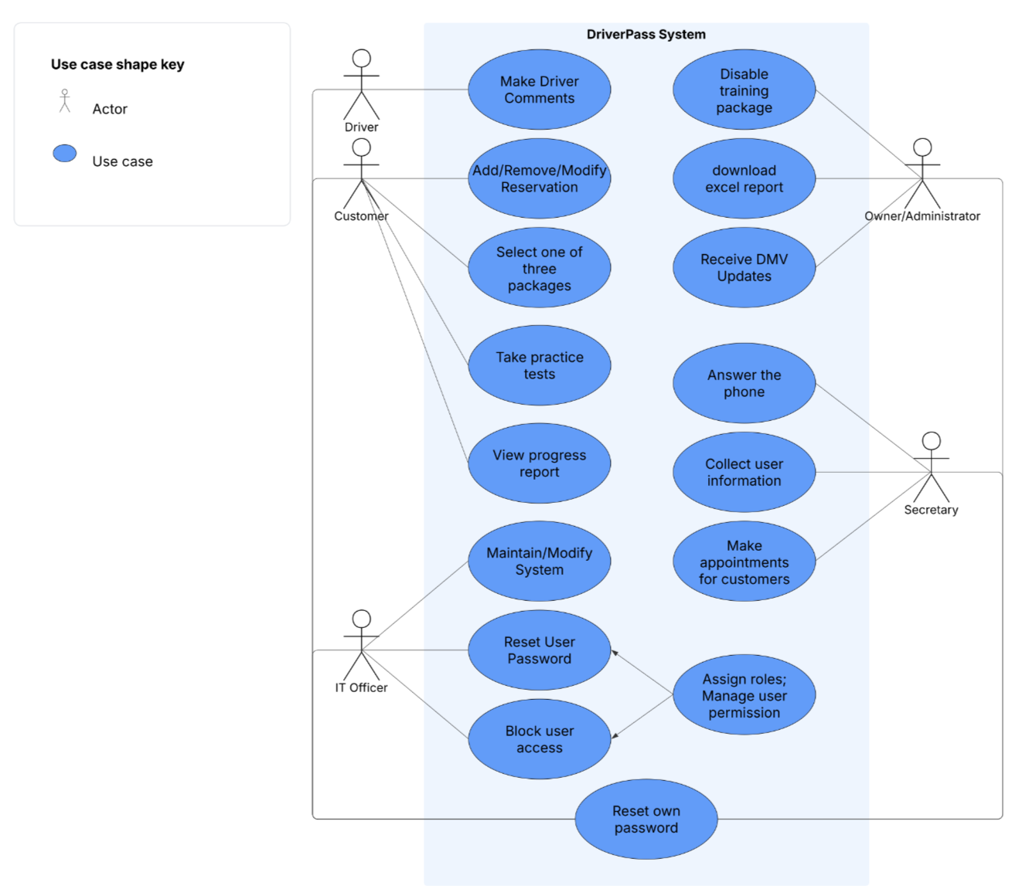
Use Case Diagram
Notes:
What you see here is a use case diagram, or in other words, scenario diagrams. This diagram is useful in terms of what the system can perform when prompted by characters of varying roles. There are several characters in this diagram; the driver, the customer, the IT officer, the owner, and the secretary.
The different scenarios – let’s say for the customer include: adding, removing, and modifying their reservation, selecting one of three training packages, taking a practice test, and viewing their progress report.
The scenario of the driver includes: making driver comments.
The scenarios of the IT officer include: maintaining/modifying the system, resetting user passwords, and blocking user access. The IT officer can also assign roles to users and manage user permission.
The scenarios of the owner include: Disabling training packages, downloading excel reports, and receiving DMV updates.
And the scenario of the secretary includes: Answer the phone, collect user information, and make appointments for customers.
A universal scenario is that all users can reset their own password.
I accounted for DriverPass needs in my design by incorporating all the potential scenarios that were mentioned in the interview, and making the appropriate associations within the graph. With this graph, we are able to view all scenarios, or cases in an easy-to-read depiction.

Slide 4
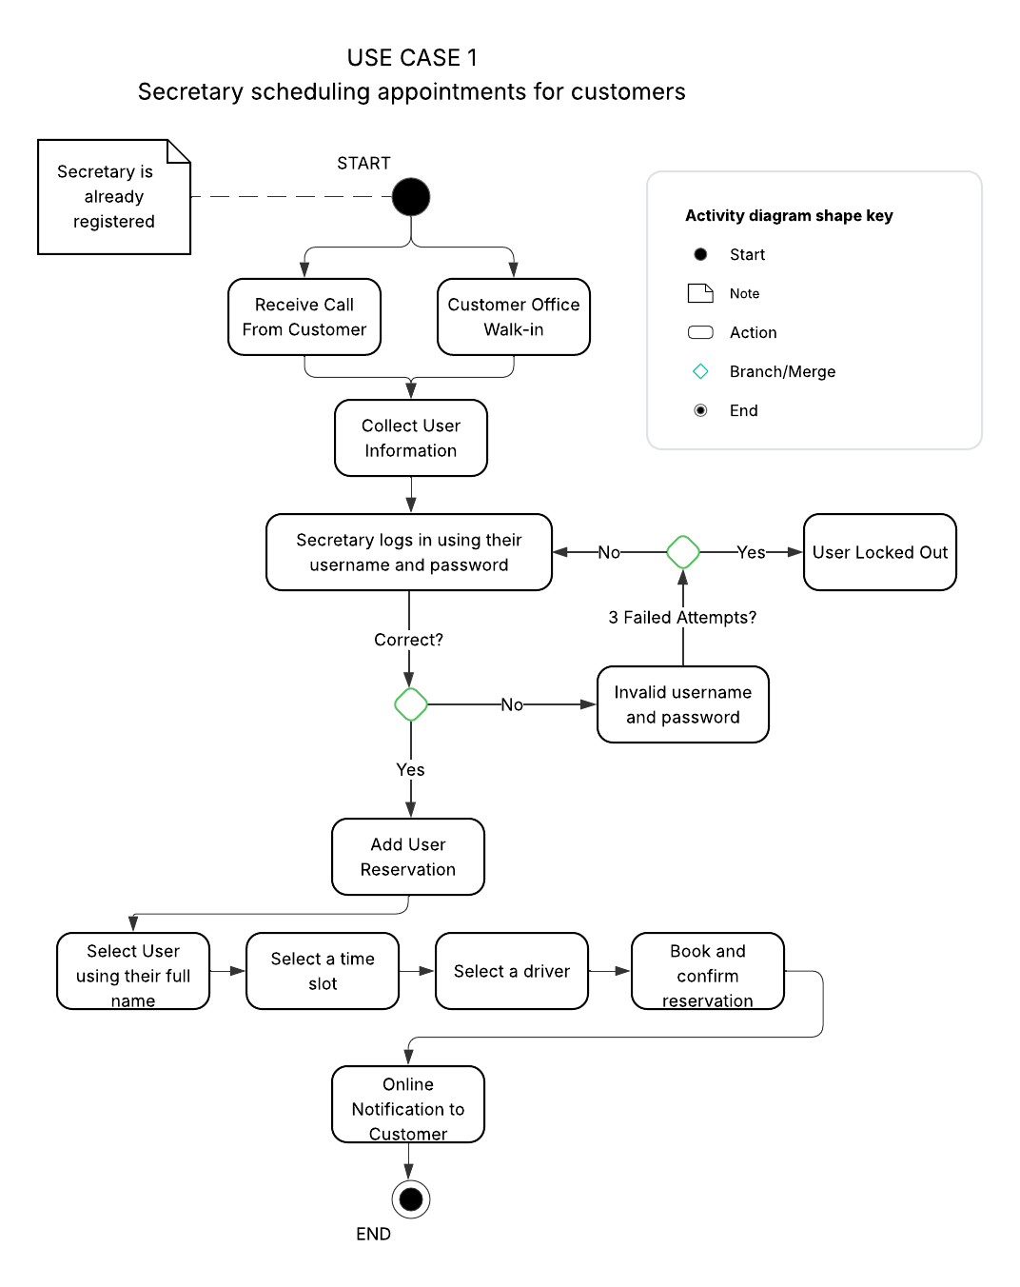
Activity Diagram
Notes:
This slide contains what we call an “Activity Diagram”. This diagram breaks down the process of the Secretary scheduling an appointment for a customer scenario. The steps involved in this use case are receiving a call from a customer and obtaining their booking information, the secretary entering his/her username and password to verify login information in the system, adding user reservation, selecting a time slot, selecting a driver, and confirming the reservation. From there a notification is sent to the Customer directly.
I have accounted for DriverPass’s needs in my design by incorporating, from start to finish, what the secretary has to perform to be able to successfully book a reservation for a customer, which includes a fail-safe process for multiple failed attempts. The activity diagram begins at the top where there is a black dot, and ends at the bottom where there is a black dot enclosed in a circle.

Slide 5
Security
The requirements for users to log in are:
Access to either a mobile device or computer
Username
Password
If there is a “brute force” hacking attempt, the account should:
Lock out for a period of time if multiple failed login attempts have been made
Send an email to the associated user, notifying them of the attempted logins
Automatic notification to the administrator
If the user forgets their password:
The users should have the option to reset their password via an email notification.
Notes:
I considered security in my design by utilizing a standard login system requiring a username and password match in order to gain access to a user’s account. Multiple attempts to login with incorrect credentials should lock users out of further login attempts. If this were to happen, a notification should be sent to the email of the owner of that account. If the user happens to forget their password, they have the ability to change their password; or if they speak to the IT officer, they can request them to change it.
There is also the consideration of user roles among customers, IT officers, administrators, and drivers. In order to protect administrator privileges, utilizing the RESTful API can effectively restrict access to unauthorized users.

Slide 6
System Limitations
Limitations I see in my system design:
Technology
The administrator requiring a developer to add or remove training modules
Platform compatibility and adaptability among mobile devices and computers
Resources
The users requiring a stable internet connection for up-to-date DMV study material
Budget
Additional financial means for future user-base expansion
Monthly cost for cloud-based databases
Time
The time required to training developers on new technologies and frameworks in future software iterations
Notes:
The limitations of my design include the amount of time required for developers to be trained, the budget the owner has to implement all the requirements requested, a stable internet connection to ensure full utility of the product, and the necessity of developers to add or remove training modules as requested by the administrator. The application must also be compatible among multiple devices, which can play into the time required for developers to finish the project.

